Slide 1
RailNL
Koos Hintzen
Simon Kemmere
Rutger van Heijningen

Slide 2
Inhoudsopgave
Undirected graph
Algoritmen
Vergelijken

Slide 3
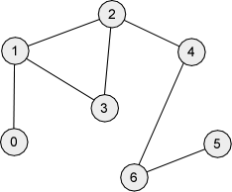
Undirected graph
Stations als nodes
Trajecten als vertices
Representatie van graph
Adjacency list
graph = {'A': ['B', 'C'],
'B': ['C', 'D'],
'C': ['D'],
'D': ['C'],
'E': ['F'],
'F': ['C']}

Slide 4
Algoritmen
Iterative
Breadth First Search
Hill climber
Constructive
Dijkstra’s algoritme
A*

Slide 5
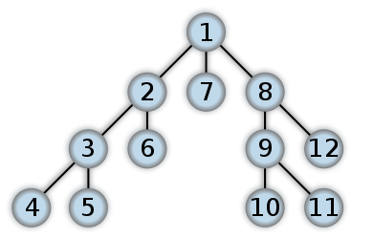
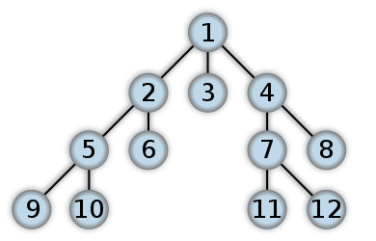
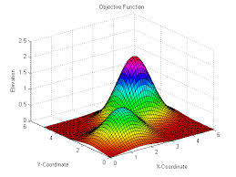
Algoritmen - iterative
Breadth First vs. Depth First
Hillclimber

Slide 6
Vergelijken
DFS is in stacks
Last in first out
Minder geheugenverbruik
BFS is in queues
First in first out

